Slide 1
Linked Lists
Instructors:
Md Nazrul Islam Mondal &
Rizoan Toufiq
Department of Computer Science & Engineering
Rajshahi University of Engineering & Technology Rajshahi-6204

Slide 2
Outline
Introduction
Linked List
Representation of Linked Lists in Memory
Traversing a Linked List
Searching a Linked List
Memory Allocation; Garbage Collection
Insertion into a Linked List
Deletion from a Linked List
Header Linked List
Two Way Lists
Arrays, Records and Pointers

Slide 3
Traversing a Linked List
Arrays, Records and Pointers

Slide 4
Traversing a Linked List
START
 | INFO
0 | 9
1 | 5
2 | 1
3 | 3
4 | 7
5 | 6
6 | 10
7 | 4
8 | 15
9 | 11
LINK
2
3
4
5
6
7
8
9
1
-1
0
Arrays, Records and Pointers

Slide 5
Traversing a Linked List
Algorithm 5.1: LIST is a linked list in memory. This algorithm traverses LIST, applying an operation PROCESS to each element of LIST. The variable PTR points to a node currently being processed.
    Set PTR:=START
    Repeat steps 3 and 4 while PTR≠NULL
    Apply PROCESS to INFO[PTR]
    SET PTR := LINK[PTR]
    [End of Repeat 2 loop]
    Exit
Arrays, Records and Pointers

Slide 6
Searching a Linked List
Arrays, Records and Pointers

Slide 7
Searching a Linked List
(LIST is unsorted)
START
 | INFO
0 | 9
1 | 5
2 | 1
3 | 3
4 | 7
5 | 6
6 | 10
7 | 4
8 | 15
9 | 11
LINK
2
3
4
5
6
7
8
9
1
-1
0
Arrays, Records and Pointers

Slide 8
Searching a Linked List
(LIST is unsorted)
Algorithm 5.2: SEARCH (INFO, LINK, START, ITEM, LOC)
LIST is a linked list in memory. This algorithm finds the location LOC of the node where ITEM first appears in LIST, or sets LOC-NULL.
    Set PTR:= START
    Repeat steps 3 and 4 while PTR≠NULL
    If ITEM = INFO[PTR] then:
    Set LOC:=PTR and Exit.
    Else:
    SET PTR := LINK[PTR]
    [End of If statement]
    [End of Repeat 2 loop]
    [Search is unsuccessful] Set LOC:=NULL
    Exit
Arrays, Records and Pointers

Slide 9
Searching a Linked List
(LIST is sorted)
START
 | INFO
0 | 1
1 | 6
2 | 2
3 | 7
4 | 3
5 | 8
6 | 4
7 | 9
8 | 5
9 | 10
LINK
2
3
4
5
6
7
8
9
1
-1
0
Arrays, Records and Pointers

Slide 10
Searching a Linked List
(LIST is sorted)
Algorithm 5.3: SRCHSL (INFO, LINK, START, ITEM, LOC)
LIST is a sorted linked list in memory. This algorithm finds the location LOC of the node where ITEM first appears in LIST, or sets LOC-NULL.
    Set PTR:= START
    Repeat steps 3 and 4 while PTR≠NULL
    If ITEM<INFO [PTR], then:
      Set PTR:= LINK[PTR]
Else if ITEM = INFO [PTR] then:
      Set LOC:=PTR and Exit.
Else:
      SET LOC:= NULL, and Exit
      [End of If statement]
      [End of Repeat 2 loop]
    [Search is unsuccessful] Set LOC:=NULL
    Exit
Arrays, Records and Pointers

Slide 11
Searching a Linked List
Source Code
Arrays, Records and Pointers

Slide 12
Memory Allocation; Garbage Collection
Arrays, Records and Pointers

Slide 13
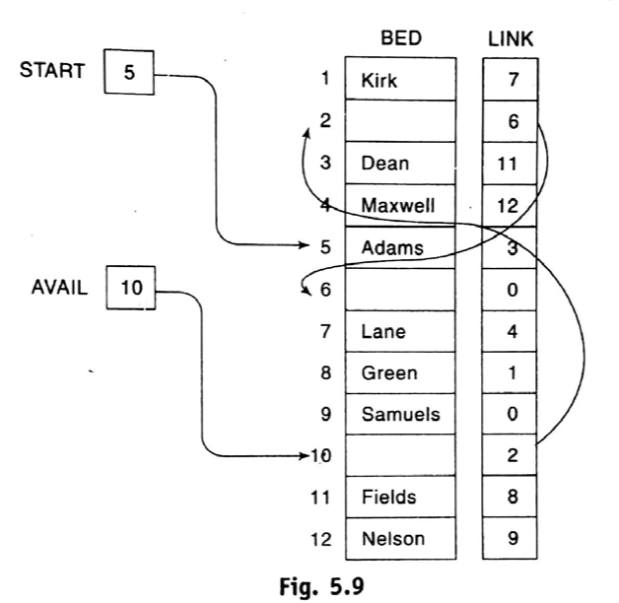
Memory Allocation; Garbage Collection
A list is maintained which consists of unused memory cells. This list is called the list of available space or the free storage list or the free pool.
Arrays, Records and Pointers

Slide 14
Memory Allocation; Garbage Collection
Garbage Collection:
  (traditional process) It is time-consuming for the operation system to reinsert the deleted node from a list into the free storage list.
  Definition of Garbage collection - The operating system of a computer may periodically collect all the deleted space into the free-storage list.
  Two steps technique:
    The computer run through all lists, tagging those cells which are currently in use.
    The computer runs through the memory, collecting all untagged space into the free-storage list.
  Take place –
    Minimum amount of space or no space at all left in the free-storage list
    CPU is idle and has time to do the collection.
    Invisible to the programmer.
Arrays, Records and Pointers

Slide 15
Memory Allocation; Garbage Collection
Overflow
  New data are to be inserted into a data structure but there is no available space i.e. the free-storage list is empty.
  Occur:
    AVAIL = NULL
Underflow
  The situation where one want to delete data from a data structure that is empty.
  Occur:
    START = NULL
Arrays, Records and Pointers

Slide 16
Insertion into a Linked List
Arrays, Records and Pointers

Slide 17
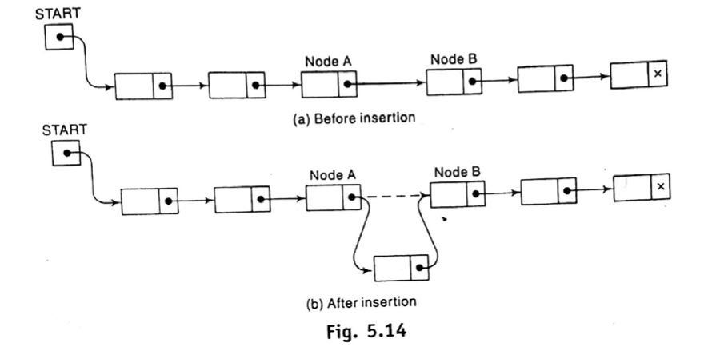
Insertion into a Linked List
Arrays, Records and Pointers

Slide 18
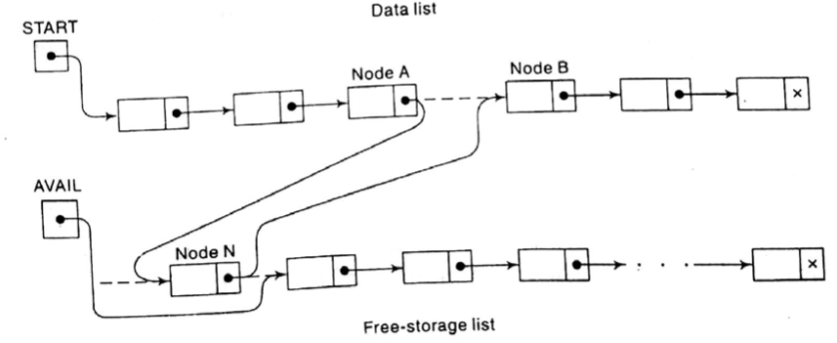
Insertion into a Linked List
Three Pointer fields are changed
Arrays, Records and Pointers

Slide 19
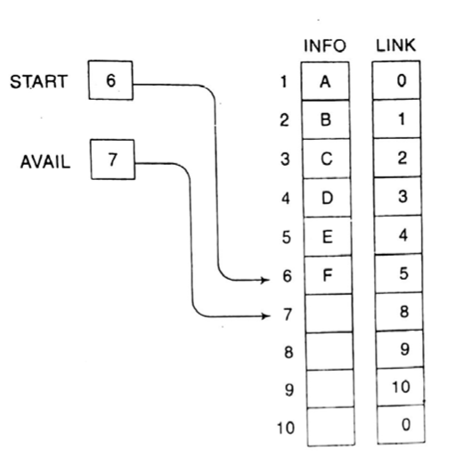
Insertion into a Linked List
Arrays, Records and Pointers

Slide 20
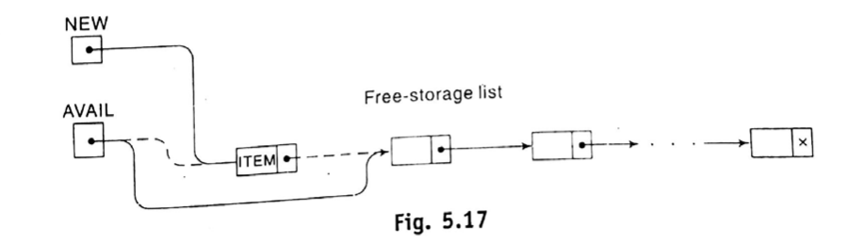
Insertion into a Linked List
Algorithm: (Create a new Node) This algorithm check available memory.
[OVERFLOW] If AVAIL = NULL, then: Write: OVERFLOW, and Exit
[Remove first node from AVAIL.]
    Set NEW:=AVAIL and AVAIL := LINK[AVAIL]
Exit
Arrays, Records and Pointers

Slide 21
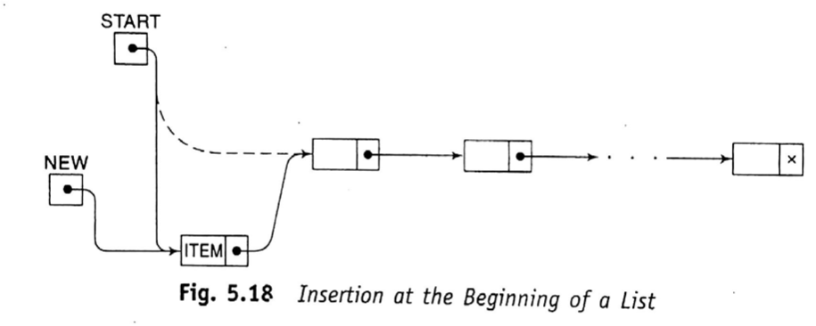
Insertion into a Linked List
(At the beginning of a List)
LINK[NEW]←START
START ←NEW
Arrays, Records and Pointers

Slide 22
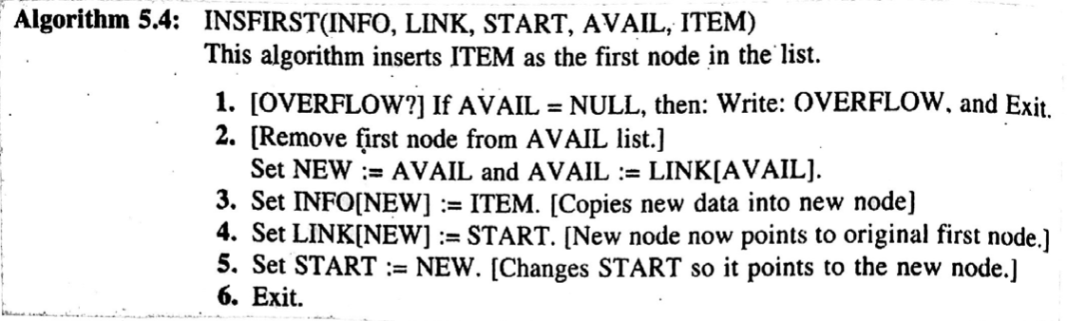
Insertion into a Linked List
(At the beginning of a List)
LINK[NEW]←START
START ←NEW
Arrays, Records and Pointers

Slide 23
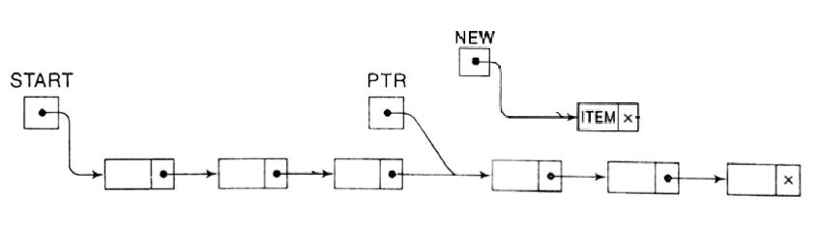
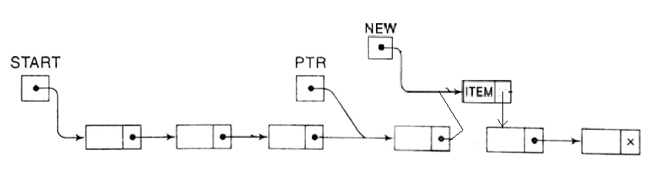
Insertion into a Linked List
(After a Given Node)
LINK[NEW]←LINK[PTR]
LINK[PTR] ←NEW
Arrays, Records and Pointers

Slide 24
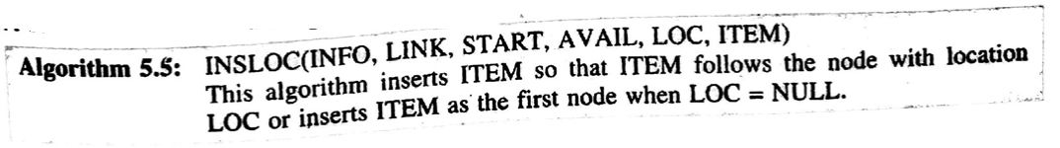
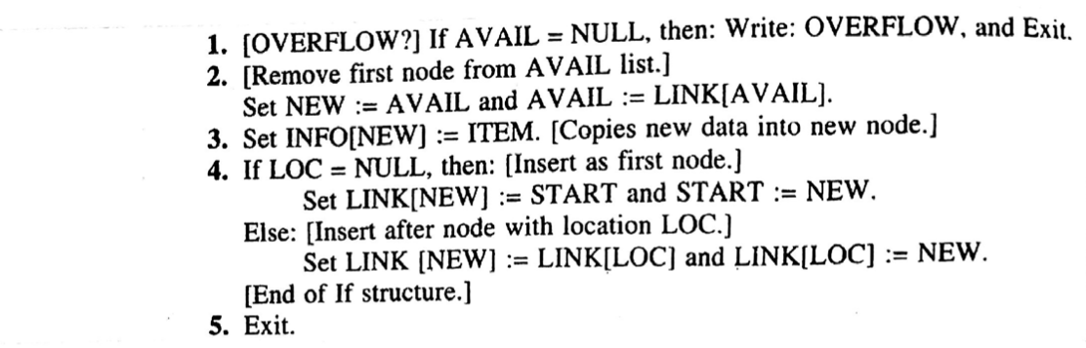
Insertion into a Linked List
(After a Given Node)
LINK[NEW]←LINK[LOC]
LINK[LOC] ←NEW
Arrays, Records and Pointers

Slide 25
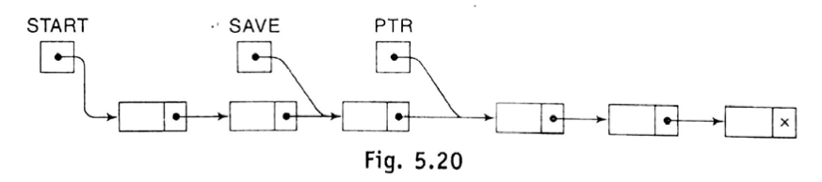
Insertion into a Linked List
(Inserting into a Sorted Linked List)
Suppose ITEM is to be inserted into a sorted linked list LIST. Then ITEM must be inserted between node A and node B
INFO(A)<ITEM≤INFO(B)
Find the location LOC of node A.
PTR pointer: Use for traversing
It is necessary to keep track the location of the preceding node
SAVE pointer: Use to track preceding Node
Arrays, Records and Pointers

Slide 26
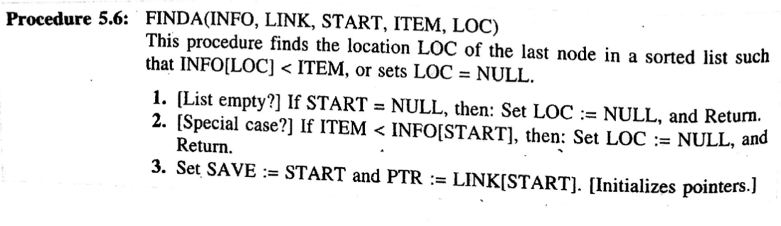
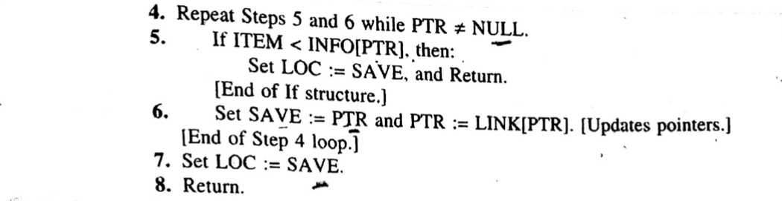
Insertion into a Linked List
(Inserting into a Sorted Linked List)
Arrays, Records and Pointers

Slide 27
Insertion into a Linked List
(Inserting into a Sorted Linked List)
LOC ←SAVE
  - Insert ITEM after a given Node i.e. INSLOC()
Arrays, Records and Pointers

Slide 28
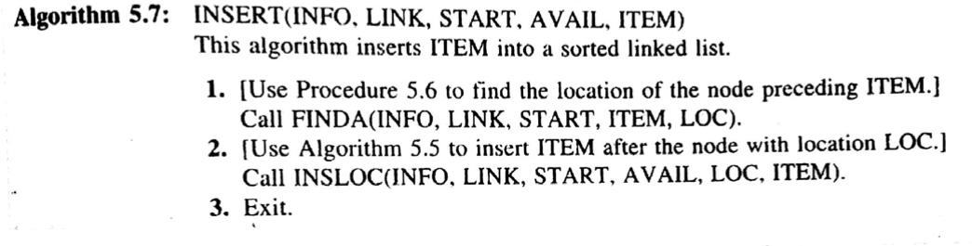
Insertion into a Linked List
(Inserting into a Sorted Linked List)
Source Code
Arrays, Records and Pointers

Slide 29
END
Arrays, Records and Pointers

